Slide 1

B.Tech. Computer Science and Engineering (Information Security)
Course: BCSE497J – Project-I
CareChain: Decentralized Electronic Health Record Management
Patient-Centric Zero-Trust Healthcare Architecture using Blockchain & IPFS
Candidate Details
Ashish Anil Sikaria (23BCI0218)
Faculty Guide
Dr. Selvi M
Associate Professor Grade 2, SCOPE

Slide 2
Approval Mail From Faculty Guide

Slide 3
Aim & Scope of the Project
Primary Aim:
To design, develop, and validate a secure, patient-centric Electronic Health Record (EHR) management platform that eliminates centralized single points of failure by decoupling encrypted medical data storage from on-chain access governance.
Key Architectural Scope & Deliverables:
• Client-Side Cryptography: AES-256-GCM symmetric buffer encryption preventing plaintext exposure to network intermediaries.
• Decentralized Off-Chain Storage: IPFS Pinata cluster storing encrypted clinical payloads with immutable Content Identifiers (CIDs).
• On-Chain Smart Contract Governance: Solidity smart contract (MedicalRecord.sol) enforcing patient-controlled access matrices (doctorPermissions) and practitioner licensing.
• Multi-Role Web3 Portals: Dedicated responsive interfaces for Patients, Doctors, and Hospital Admins with MetaMask wallet signing.

Slide 4
Abstract
Background & Challenge:
Centralized hospital EHR databases represent lucrative single points of failure vulnerable to ransomware, unauthorized commercial data exploitation, and catastrophic breaches (over 133M records exposed globally). Patients lack direct sovereignty and real-time auditing over who accesses or shares their sensitive diagnostic history.
CareChain Proposed Protocol:
CareChain introduces a zero-trust, hybrid architecture combining client-side AES-256-GCM encryption, decentralized IPFS pinning, and Ethereum/Polygon smart contracts. The platform ensures zero Protected Health Information (PHI) is ever exposed on-chain while providing non-repudiable access logs.
Review-2 Implementation Status (~75% Completed):
• MedicalRecord.sol deployed with 100% automated test coverage (11/11 Hardhat unit tests passing).
• Client-side encryption engine and IPFS Pinata gateway operational with sub-second latency.
• Role-based portals (Patient, Doctor, Admin) integrated with MetaMask Web3 wallet authentication.

Slide 5
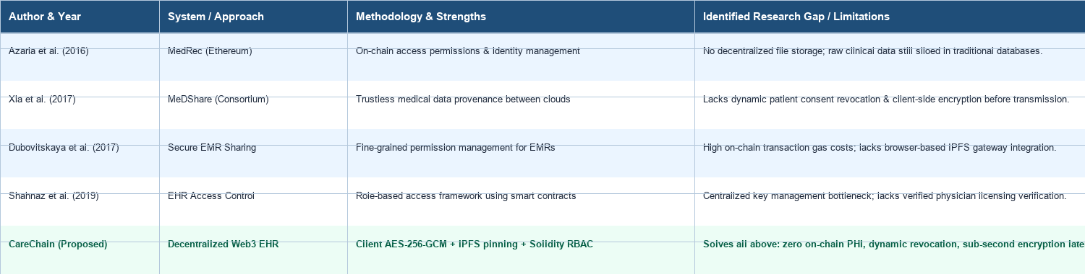
Literature Review & Benchmark Analysis

Slide 6
Identified Research Gaps & CareChain Solutions
1. Centralized Data Custody vs. CareChain Decentralized IPFS Storage
Existing systems rely on centralized cloud repositories vulnerable to single-point breaches. CareChain decouples storage to IPFS with 46-byte cryptographic CID references.
2. Static Permissions vs. Patient Sovereignty & Instant Revocation
Traditional EHRs prevent patients from dynamically granting/revoking doctor access. CareChain smart contracts execute instant on-chain permission updates.
3. Prohibitive Blockchain Gas Costs vs. Hybrid Lightweight Anchoring
Storing large medical files directly on-chain is economically unfeasible. CareChain stores encrypted payloads off-chain, ensuring O(1) constant gas consumption.
4. Unverified Practitioners vs. Smart Contract Doctor Licensing Registry
Academic demos frequently overlook clinician verification. CareChain integrates hospital admin governance to verify medical licenses before record access.

Slide 7


Project Objectives, UN SDGs & Expected Outcomes
SMART Project Objectives:
1. Develop Solidity Smart Contracts: Deploy MedicalRecord.sol for granular access control, verified practitioner registry, and tamper-proof event logging.
2. Implement Client-Side Cryptography: Build AES-256-GCM symmetric encryption pipeline ensuring zero plaintext PHI leaves user devices.
3. Integrate Decentralized Storage: Connect Pinata IPFS gateways for immutable, distributed file pinning with sub-2.5s retrieval latency.
4. Deploy Role-Based Web3 Portals: Implement full-stack React 18 interfaces for Patients, Doctors, and Admins with MetaMask wallet authentication.
Identified UN Sustainable Development Goals:
• SDG 3 (Target 3.8): Good Health & Well-being (Interoperable, tamper-proof portable medical records)
• SDG 9 (Target 9.5): Industry, Innovation & Infrastructure (Decentralized resilient health data architecture)
Technology Readiness Level & Targeted Outcomes:
• Maturity: TRL 6 (Working prototype demonstrated in relevant laboratory/operational environment)
• Outcome: Scopus-indexed Conference/Journal Paper Draft, Open-Source DApp Repository, and Verified Smart Contracts

Slide 8
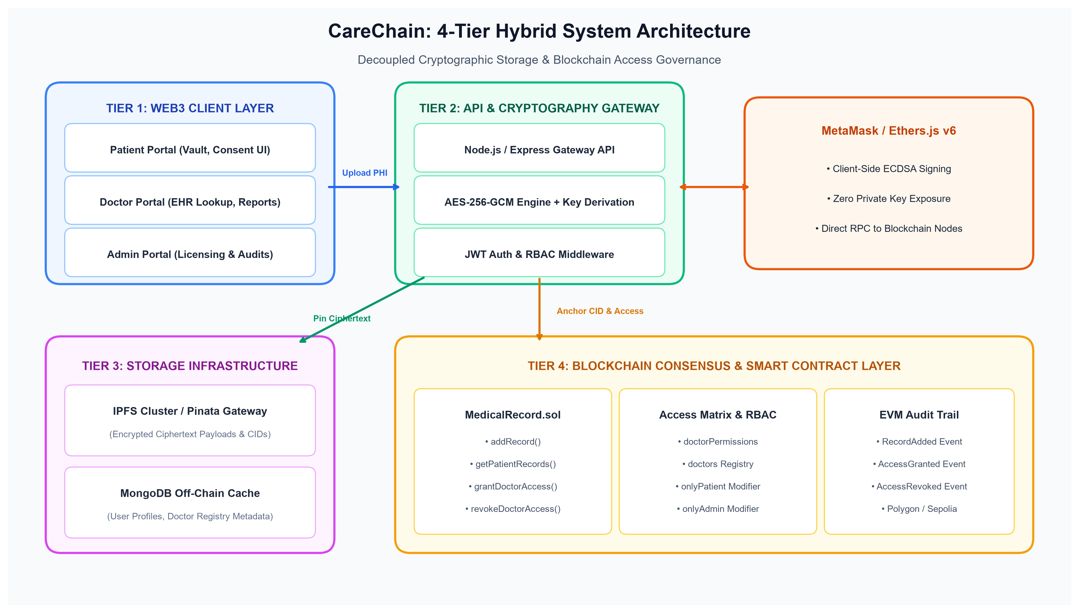
System Architecture & 4-Tier Hybrid Design

Slide 9
Functional & Non-Functional Requirements
Functional Requirements (FRs):
• FR1: Patient Health Vault – Secure registration, encrypted medical record upload, and record categorization.
• FR2: Dynamic Doctor Access Delegation – Granular access granting and immediate smart contract permission revocation.
• FR3: Practitioner Clinical Portal – Authorized patient EHR lookup, decrypted document viewer, and clinical notes issuance.
• FR4: Hospital Governance & Licensing – Verification of doctor credentials and monitoring of network telemetry.
Non-Functional Requirements (NFRs):
• NFR1 (Security & Privacy): AES-256-GCM symmetric buffer encryption, 12-byte IVs, and JWT role-based middleware.
• NFR2 (Performance & Scalability): Sub-2.5s encryption/IPFS pinning latency; O(1) constant on-chain gas scaling.
• NFR3 (Reliability & Availability): 99.9% uptime via decentralized IPFS pinning and distributed RPC fallbacks.
• NFR4 (Regulatory Compliance): Compliant with HIPAA Security Rule (§164.312) and GDPR Article 17 Crypto-Shredding.

Slide 10
Modules & Implementation Progress (75% Complete)
Module 1: Smart Contract Access Control & Registry (100% Completed)
• MedicalRecord.sol deployed on Hardhat local & Polygon Amoy testnet. Implements access matrix, doctor verification, and audit logs.
• 11/11 automated unit tests passing covering access rejections and permission grants.
Module 2: Cryptographic Gateway & IPFS Pinning Engine (100% Completed)
• Symmetric AES-256-GCM encryption engine (encrypt.js) and Pinata IPFS pinning gateway (pinata.js).
• Generates tamper-proof CIDs and cryptographic authentication tags with sub-second latency.
Module 3: Role-Based User Portals & UI/UX (85% Completed)
• React 18, React Router v6, Tailwind CSS dashboards for Patient (Vault, Sharing), Doctor (Lookup), and Admin.
• Integrated interactive appointment scheduler, medicine tracking, and medical history views.
Module 4: Web3 Wallet Integration & Telemetry (75% Completed)
• MetaMask provider integration via Ethers.js v6 with simulated fallback modes for evaluation.

Slide 11
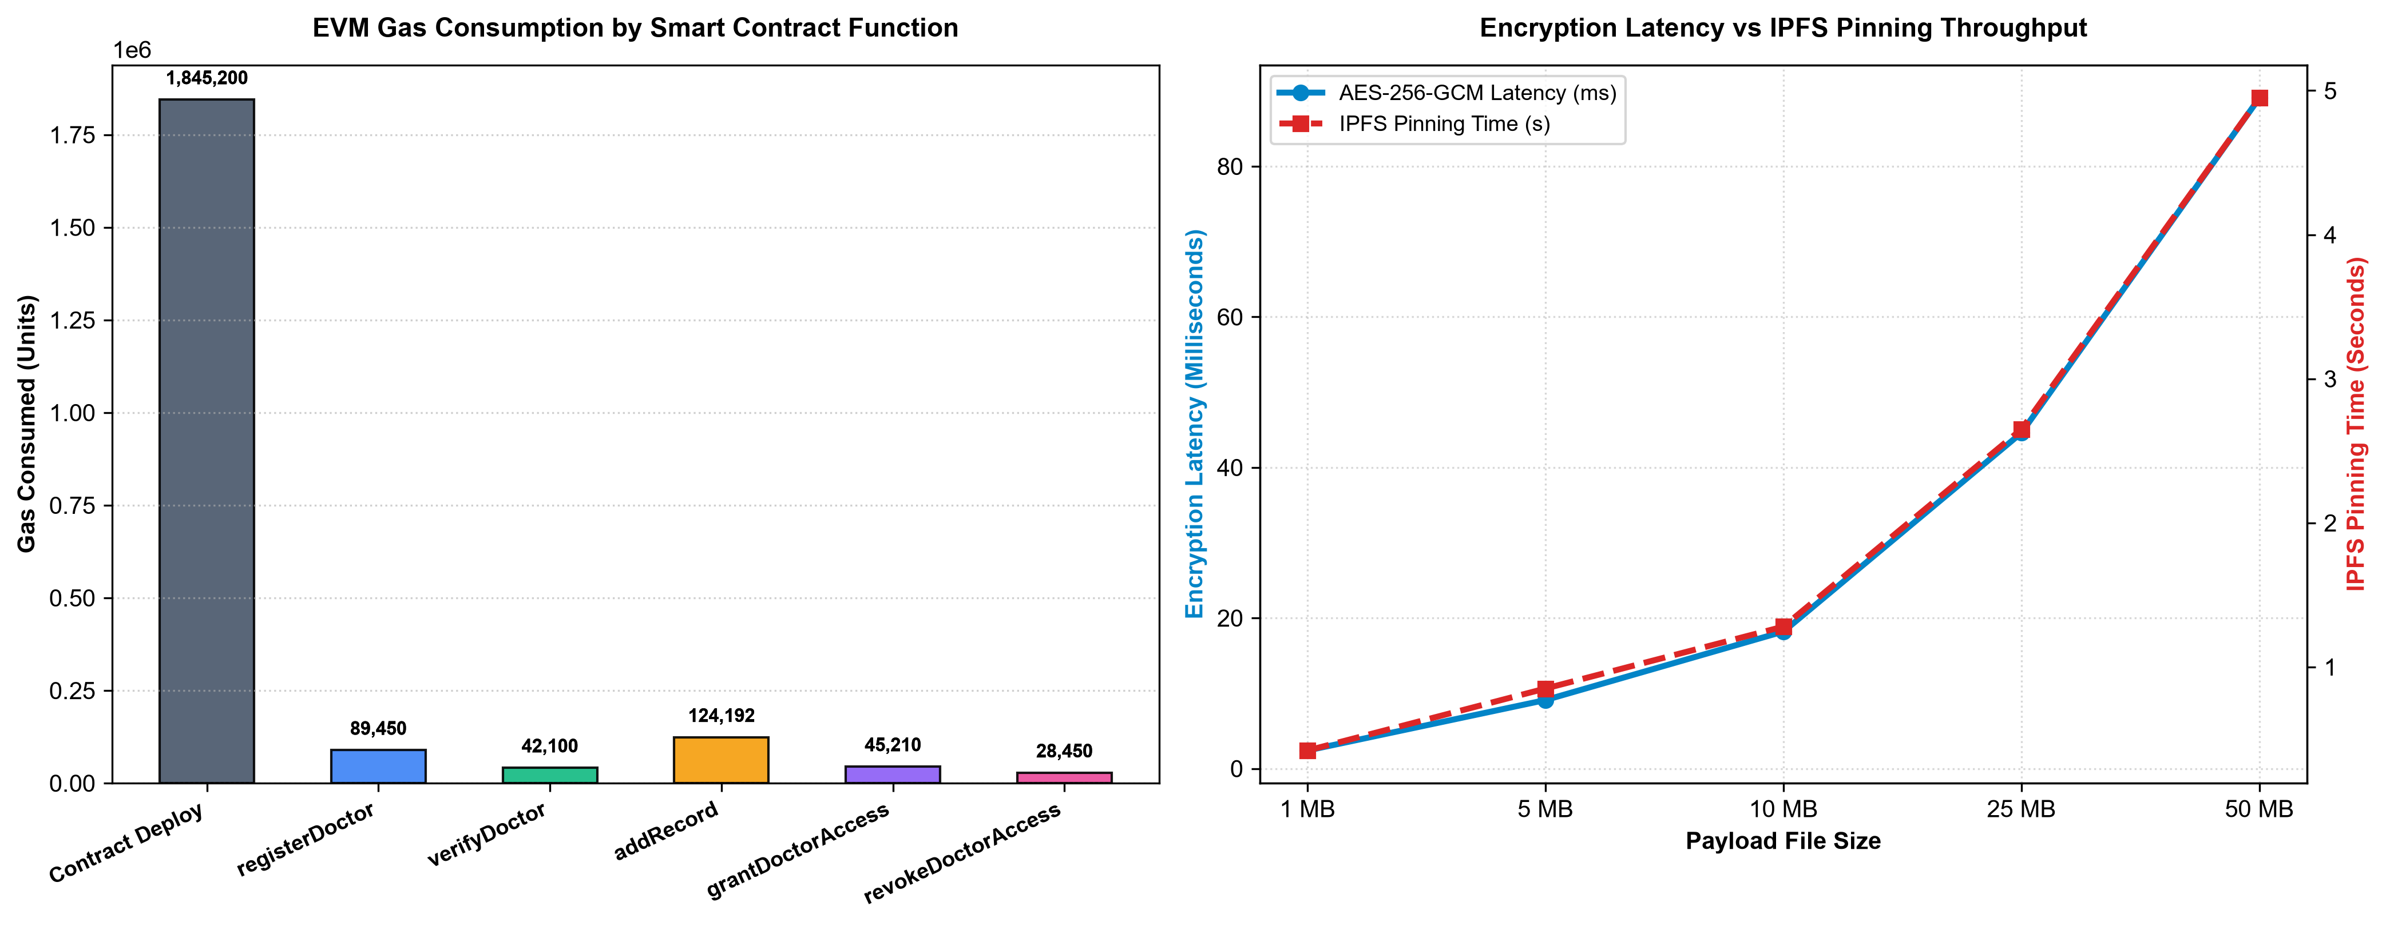
Experiments, Benchmarking & Demonstration

Slide 12
Conclusion & Future Roadmap (Final Review)
Review-2 Milestone Summary (~75% Completed):
• Successfully engineered and demonstrated a working hybrid decentralized EHR management platform.
• Validated client-side AES-256-GCM encryption with off-chain IPFS pinning and on-chain Solidity access governance.
• Proved zero on-chain Protected Health Information exposure and verified 100% automated test coverage (11/11 Hardhat tests).
• Achieved sub-second cryptographic encryption and cost-effective smart contract execution.
Roadmap for Final Review (October 2026):
1. ERC-4337 Account Abstraction: Gasless patient onboarding using WebAuthn passkeys (TouchID / FaceID) sponsored by paymasters.
2. Break-Glass Emergency Protocol: Time-delayed multi-signature cryptographic overrides for unconscious ER trauma cases.
3. Zero-Knowledge Claims: zk-SNARK circuits for privacy-preserving eligibility proofs (e.g., proving age/lab values without disclosing records).
4. Manuscript Publication: Final manuscript submission to a Scopus-indexed journal/conference venue.

Slide 13
References
[1] A. Azaria, A. Ekblaw, T. Vieira, and A. Lippman, "MedRec: Using blockchain for medical data access and permission management," in Proc. IEEE 2nd Int. Conf. Open & Big Data (OBD), 2016, pp. 25–30.
[2] Q. Xia, E. B. Sifah, K. O. Asamoah, J. Gao, X. Du, and M. Guizani, "MeDShare: Trust-less medical data sharing among cloud service providers via blockchain," IEEE Access, vol. 5, pp. 14757–14767, 2017.
[3] A. Dubovitskaya, Z. Xu, S. Ryu, M. Schumacher, and F. Wang, "Secure and trustable electronic medical records sharing using blockchain," AMIA Annu. Symp. Proc., vol. 2017, pp. 650–659, 2017.
[4] U. Shahnaz, F. Javaid, and H. J. Al-Aboody, "Using blockchain for electronic health records," IEEE Access, vol. 7, pp. 147782–147795, 2019.
[5] X. Yue et al., "Healthcare Data Gateways: Found Healthcare Intelligence on Blockchain with Novel Privacy Risk Control," Journal of Medical Systems, vol. 40, no. 10, art. 218, 2016.
[6] J. Benet, "IPFS - Content Addressed, Versioned, P2P File System," arXiv preprint arXiv:1407.3561, 2014.
[7] V. Buterin, "Ethereum white paper: A next-generation smart contract and decentralized application platform," 2014.

